Slide 1


IPL Win Predictor
Presented by:Saroj Lamichhane

Slide 2
Introduction
This presentation introduces the IPL Win Predictor, a minor project aimed at predicting the outcomes of IPL matches. The project utilizes machine learning techniques to provide insights into match dynamics and support decision-making for IPL enthusiasts and stakeholders.

Slide 3
Project Overview
The IPL Win Predictor project focuses on predicting match outcomes based on historical IPL match data. It employs Python programming language and libraries such as Pandas, NumPy, scikit-learn, and Streamlit. Key features include match parameter calculation, win probability prediction, and user-friendly interface development. Challenges faced include data preprocessing complexities and model selection.

Slide 4
Methodology
The project adopts a data-driven approach, utilizing historical match data for model training and evaluation. Machine learning models, including Logistic Regression and Random Forest Classifier, are employed for outcome prediction. Streamlit is used for web application development, providing an interactive interface for user interaction.

Slide 5
Implementation
The project is implemented using Python programming language within a Jupyter Notebook environment. It involves data preprocessing, model training, and web application development. Model serialization using pickle facilitates model deployment, while Streamlit simplifies web app development.

Slide 6
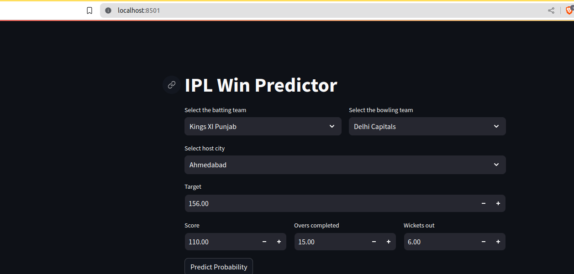
Key Features
The IPL Win Predictor offers features such as team selection, city selection, and match parameter input for result prediction. It provides win probabilities for both batting and bowling teams based on user inputs. The user-friendly interface enhances user experience and facilitates intuitive interaction.

Slide 7
Results
The project achieved promising results in predicting IPL match outcomes, with an accuracy score of [insert accuracy score]. The system's performance was evaluated using a test dataset, demonstrating its effectiveness in predicting match results and providing valuable insights.

Slide 8
Challenges Faced
Challenges encountered during the project development included data preprocessing complexities and model selection. However, these challenges were addressed through iterative experimentation and collaboration within the team.

Slide 9
Challenges Faced
Challenges encountered during the project development included data preprocessing complexities and model selection.

Slide 10
Thank You!

